Slide 1
Customer Feedback Tool
]

Slide 2
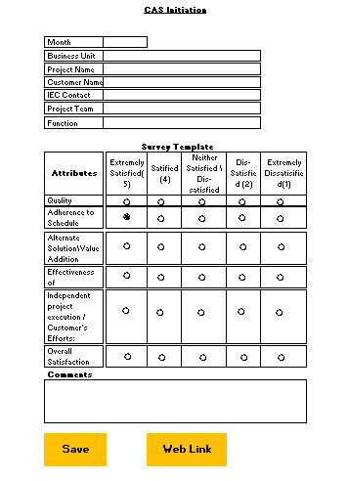
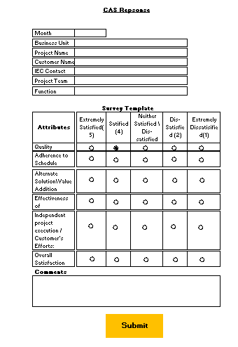
CAS Initiation & Response
Email Web link to the customer,
Customer opens the weblink Fills the form & submits

Slide 3
Reports
CAS report by month (Overall score) – Bar Chart
CAS report by BU - Bar Chart
CAS Report by Function – Bar Chart
Initiated Vs Received % - Bar Chart
CAS Report (month) – By count on the scores (Example Listed below)

